Slide 1
PROJECT TITLE – RENTEASE APLICATION
DEVLOPE BY :- 1.AMRUTA SOBALE.
2. ANIKET PATIL.

Slide 2
Abstract
RentEase is a full-stack peer-to-peer rental platform designed to connect individuals who want to rent products with those who wish to lend them for short durations. The platform addresses the problem of underutilized assets and the high cost of short-term ownership by providing a secure, easy-to-use system for listing, searching, and booking items.
The application allows users to register, list products, browse available items, and complete bookings through an integrated payment gateway. It includes essential features such as user authentication, product filtering, real-time availability, and a review system to build trust among users.
Developed using modern web technologies such as Angular (frontend), Spring Boot (backend), and MySQL (database), RentEase aims to reduce consumer costs, encourage reuse, and promote a sustainable sharing economy.
This project demonstrates a scalable and efficient solution to real-world rental needs, combining usability, security, and functionality in one unified platform.

Slide 3
INTRODUCTION
What is RentEase? RentEase is a peer-to-peer rental platform designed to connect renters for short-term product or property rentals. It enables users to lend or rent items such as Clothing & Accessories, Home Essentials, Electronics & Entertainment, Event & Decoration, Tools & Equipment with ease and transparency.
Purpose of the Application: To make renting more accessible, reduce unused assets, and provide a secure, user-friendly system for peer-to-peer transactions.
Target Audience:
Individuals with idle assets to rent, People looking for affordable short-term rentals, College students, travelers, small businesses
Key Features:
Easy product listing and search, Secure booking and payment system, Real-time availability and user verification for trust building

Slide 4
Problem Statement
The Problem:-
Many individuals own valuable items that remain unused for long periods, such as electronics, furniture, or vehicles. At the same time, others frequently need these items for short durations but cannot afford to purchase them outright.
Key Challenges:
Lack of a reliable and user-friendly platform for short-term peer-to-peer rentals
High cost of buying items for one-time or limited use
Difficulty in finding trustworthy renters or owners
No structured system for verification, tracking, and secure transactions
Our Goal:
To create a secure, efficient, and user-friendly platform (RentEase) that bridges the gap between item owners and renters allowing people to rent or lend products conveniently and confidently.

Slide 5
objective
The main objective of the RentEase application is to design and develop a user-friendly, secure, and scalable platform that facilitates peer-to-peer rental of products and assets. The aim is to reduce idle resources, promote affordability, and build trust within a digital rental community.
Key objective:-
Build a user-friendly web application for listing and renting products.
Implement secure user authentication and verification.
Enable real-time search, filtering, and booking of rental items.
Create a trusted review and rating system to ensure reliability.
Promote reuse of underutilized resources to save costs and support sustainability.

Slide 6
METHODOLOGY
1. Requirement Gathering & Analysis :-
Identified user needs through research and analysis..Defined features like product listing, rental booking, user authentication, and payment integration.
2. System Design :-
Designed frontend using frontend technologies. Planned backend architecture and database schema.Chose technologies: Angular (Frontend), Spring Boot (Backend), MySQL(Database).
3. Frontend Development :-
Built responsive user interfaces using HTML, CSS, Bootstrap and angular. Ensured easy navigation, search, and item filtering.
4. Backend Development :-
Created RESTful APIs for product management, bookings, user handling, and transactions. Implemented business logic for availability, bookings, and notifications.
5. Database Integration:-
Designed normalized schemas to store product, user, rental, and payment data. Used MySQL for secure and fast access.

Slide 7
Future Scope
The RentEase platform has strong potential for future growth and innovation. It can evolve beyond basic peer-to-peer rentals to include advanced technologies, better user engagement, and scalability across regions and product types.
1.Mobile Application Development :-
Build native Android and iOS apps for better accessibility and real-time notifications.
2.Location-Based Suggestions:-
Integrate GPS to show nearby available rental items for faster and localized rentals.
3,Delivery & Pickup Services:-
Collaborate with delivery partners to enable doorstep delivery and return of rented items.
4,AI-Powered Features:-
Use machine learning for personalized recommendations, dynamic pricing, and fraud detection.
5.Multilingual Support:-
Add support for multiple regional languages to expand user base across diverse regions.
6..B2B Rental Features:-
Allow businesses to rent bulk items like office equipment, projectors, etc., on a recurring basis.

Slide 8
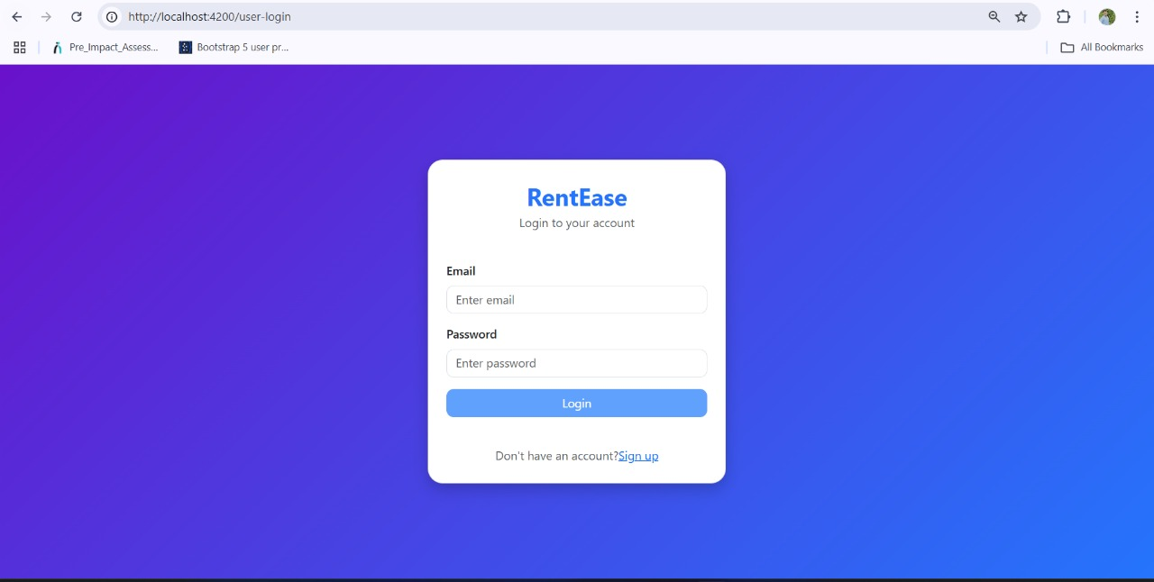
Login page:-

Slide 9
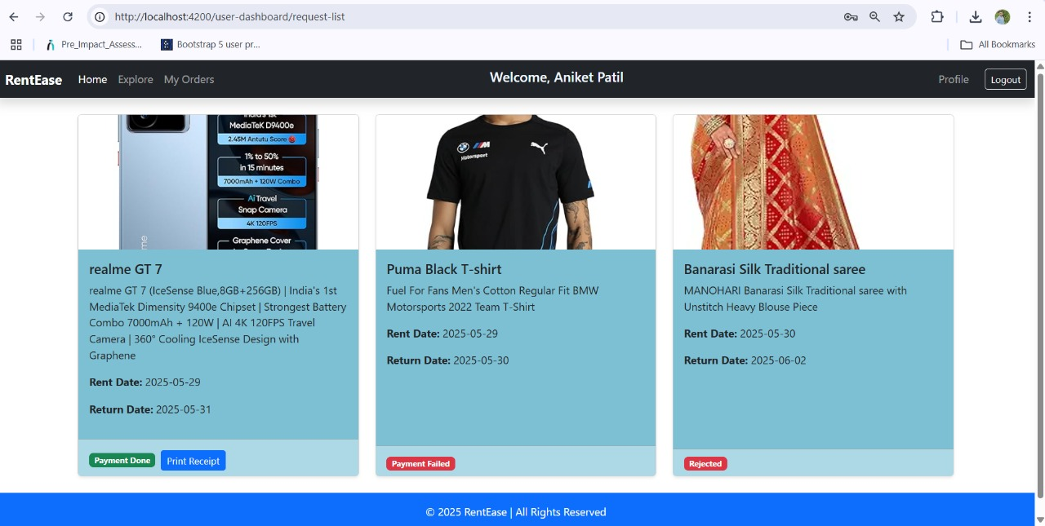
Products:-

Slide 10
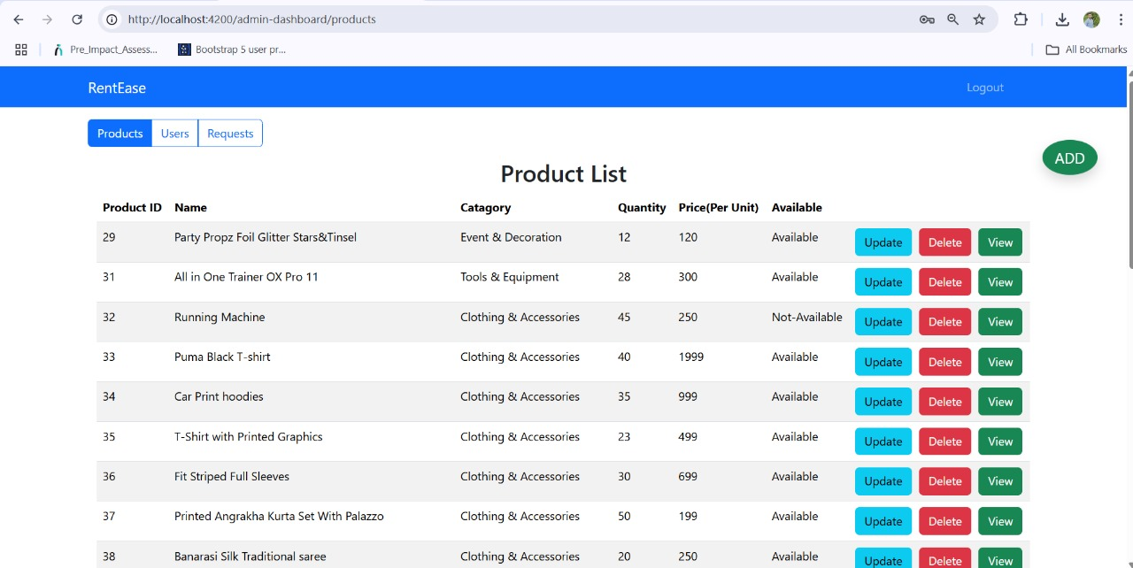
Product list:-

Slide 11
Thank you

